Slide 1
LISTENING SESSION
GUEST SPEAKERS:
PROF CLIFF RANSOM WENDEL B. LILANGAN
PROF NARUMON CHUMCHAROENSUK

Slide 2
Pre-test

Slide 3
Pretest
Item 1

Slide 4
Pretest: Item 1
Item 1
What is the lady referring to?
CD
Folder
USB Flash drive

Slide 5
Pretest
Item 2

Slide 6
Pretest: Item 2
Item 2
What did the couple buy?
Microwave Oven
Washing Machine
Dishwasher

Slide 7
Pretest
Item 3

Slide 8
Pretest: Item 3
Item 3
What do you think is being described as “smells crispy clean and are filled with real feathers?”
Pillow
Blanket
Curtains

Slide 9
End of Pre-test

Slide 10
Tips and Guides
Tip 4: Practice - listening to real-life English conversations
Tip 1: Remember YOLO (You Only Listen Once)
Tip 3: Actively listen - NEVER lose attention
Tip 2: Know your synonyms

Slide 11
Listening 1
Introducing A Friend

Slide 12
Listening 1

Slide 13
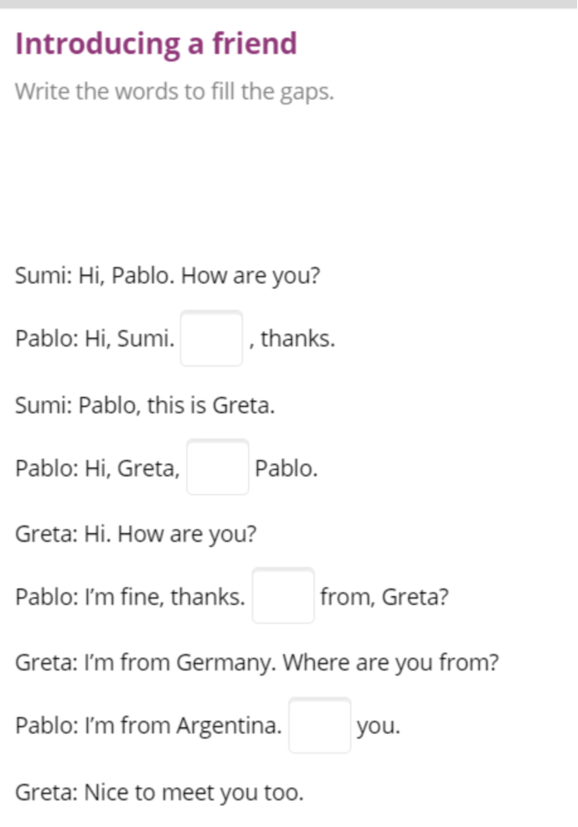
Listening 1

Slide 14
Listening 1

Slide 15
Listening 1
Transcript
Pablo: I'm fine, thanks. Where are you from, Greta?
Greta: I'm from Germany. Where are you from?
Pablo: I'm from Argentina. Nice to meet you.
Greta: Nice to meet you too.
Sumi: Hi, Pablo. How are you?
Pablo: Hi, Sumi. I'm fine, thanks.
Sumi: Pablo, this is Greta.
Pablo: Hi, Greta, I'm Pablo.
Greta: Hi. How are you?

Slide 16
Listening 1
Reference
https://learnenglishteens.britishcouncil.org/skills/listening/beginner-a1-listening/introducing-friend

Slide 17
Listening 2
Advice for Exams

Slide 18
Tips and Guides
Tip 5: Take notes

Slide 19
Listening 2

Slide 20
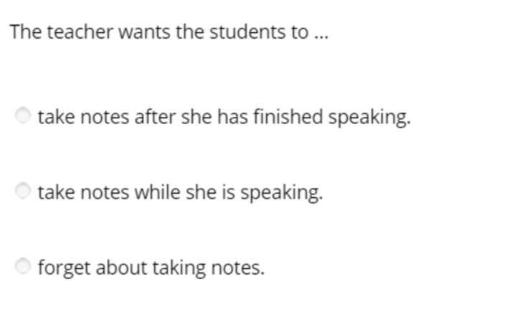
Listening 2

Slide 21
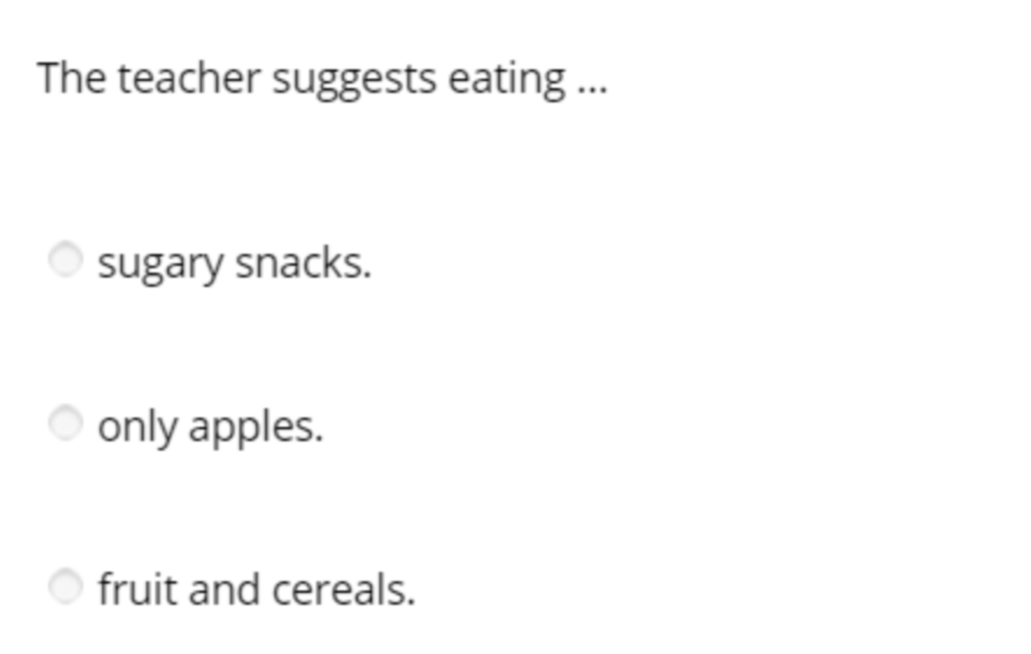
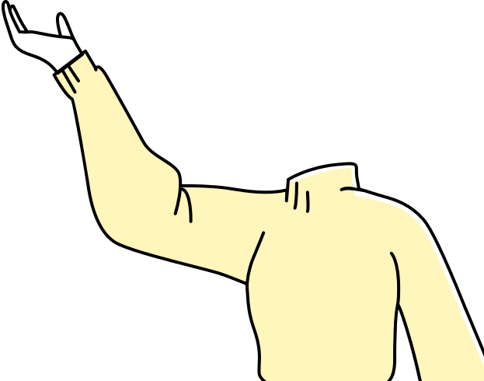
Listening 2

Slide 22
Listening 2
Transcript
Morning, everyone. Quiet, please. Right, OK. So, today I’m going to give you some advice to help you prepare for the exams next week. So, make some notes as I’m talking, please. Everybody ready?
Now, while you’re studying, eat food that gives you energy. Don’t be tempted to eat sweets or drink cola. Sugar won’t help you study but fruit and cereals will. Apples, actually, are especially good.
Find a comfortable place with plenty of light when you study. But not ‘too’ comfortable or you’ll fall asleep!
Try and keep a positive mind. It is easier to study when you are positive and relaxed. Now, if you start feeling anxious, have a little break. Go out for a stroll around the block..

Slide 23
Listening 2
Transcript
Don’t try to learn everything. There isn’t time. Just choose the ‘important’ things, the things that’ll get you the most points in an exam. And if you aren’t sure about this, ask me.
First, learn the main ideas and don’t worry too much about the details. If you have time, you can come back later and read the details.
Make notes of these key points and read them, then cover them up and try to remember all the points. Now, it might be boring, but repetition helps you to remember.
Use past exam papers to study. They will help you understand what kind of questions come up. There are plenty of past exam papers in the library. You can photocopy them and take them home.

Slide 24
Listening 2
Transcript
Take regular breaks while you’re studying. A five-minute break every half hour is usually enough. Get some fresh air and stretch your arms and legs. Drink a glass of water too. It’s important to keep hydrated.
And, last but not least, good luck! I’m sure you’ll all do your best.
END

Slide 25
Listening 2
Reference
https://learnenglishteens.britishcouncil.org/skills/listening/intermediate-b1-listening/advice-exams

Slide 26
Listening 3
Sports Centres

Slide 27
Tips and Guides
Tip 6: Listen for context clues

Slide 28
Listening 3

Slide 29
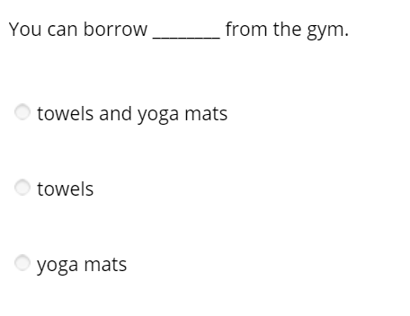
Listening 3

Slide 30
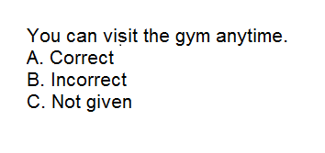
Listening 3

Slide 31
Listening 3
Transcript: Gym A
Hi, come in. I’m Maya. Hello everybody. Welcome to the Grange Park Sports Centre. I’ll just show you round the centre and explain what we offer here, and then you can ask me questions.
Well, as you can see, this is quite a small centre but we offer a lot of different activities at different times of the day. If you’d just like to come through here, you can see the main rooms. These are nice and light and airy and we have a very good air-conditioning system so they are warm in the winter and cool in the summer.

Slide 32
Listening 3
Transcript: Gym A
Here we have classes of yoga, tai chi, Pilates and Zumba at different levels. We also have different types of dance class: jazz dancing, Indian dancing and Latin dancing. Oh, and we’ve just started offering flamenco. All our teachers are fully qualified and experienced. We have beginners’ classes up to advanced. Some of our students have been coming since we opened, ten years ago.
So, if you could follow me through here - mind the steps here - we’ve got the sauna and massage rooms. We have very reasonable prices for massages. And over here we have the gym with exercise machines. It’s quite a small gym, but usually there’s plenty of room for people to move around without any problems.

Slide 33
Listening 3
Transcript: Gym A
OK, that’s about it. Over there we have the changing rooms with showers. You do need to bring your own towel if you want a shower, but you don’t need to bring a mat for the yoga and Pilates classes. Oh, and I must mention the café. It’s just off the main entrance. That’s very popular with our clients; we have a great selection of teas, fresh juices, sandwiches and cakes.
Right, the prices. You can join for three months, six months or a year and that gives you the right to use the gym and go to two classes a week. If you want to go to more classes or use the sauna, there’s a small extra charge. For three months the fee is...

Slide 34
Listening 3
Transcript: Gym B
OK, let me show you the gym. My name’s Bill and I’m the main sports trainer here, but we have a team of four specialists who are always around to help you with exercise programmes and give advice about lifestyle and diet. We strongly recommend that you talk to one of us as soon as you sign up and set up your personalised training programme.
So, through here we have the main gym. As you can see, it’s enormous and we have lots of brand-new machines. You can do everything here, running, cycling, rowing, weights … you name it. Although we have a lot of clients, it’s very unusual to have to wait for a machine. Over there is the area for weight-training.

Slide 35
Listening 3
Transcript: Gym B
If you want a closer look at the machines, you can come back later. Oh, by the way, you can only come in here with trainers on. No outdoor shoes, please.
OK, through here we have the swimming pool. It’s great, isn’t it? We’re very proud of it. You can use it most of the time without booking, but there are certain times of day when we have swimming classes and water aerobics. There is always a lifeguard in attendance who will also offer informal swimming tips.

Slide 36
Listening 3
Transcript: Gym B
OK, just over there you have the changing rooms and lockers, and on te right are the bathrooms and showers. We have our own shop, here, where you can buy our own brand of sportswear and sports drinks and supplements. Right, I can see you’re impressed, and as I said, we’re very proud of our centre. However, I should warn you that we ar eslightly more expensive than other gymns in the area - but then we offer a much higher level of services and a very wide range of activities.
Here’s a brocher with the timetables of the extra classes that we offer, such as boxing, taekwondo, and capoeira and quite a few others, besides swimming activities: swimming classes, diving classes, water aerobics and water polo. OK, so have a look at the brochure, then you can speak to one of the secretaries in reception about the best combination of activities for you.

Slide 37
Listening 3
Reference
https://learnenglishteens.britishcouncil.org/skills/listening/intermediate-b1-listening/sports-centres

Slide 38
Post-test
Items in a Flat

Slide 39
Listening 4
Item 4

Slide 40
Listening 4
Item 4
These loads of pairs refer to...
Pliers
Scissors
Hammer

Slide 41
Listening 4
Transcript
Boy: We must have loads of pairs, but however hard I search, I can never find them.
Girl: Look in the drawer over there. There'll be some amongst my sewing materials.
Boy: Are they suitable for the job though? They've got to be sharp enough for the carpet.
Girl: Ah, maybe not. Use the ones in the toolbox then.
Boy: Got them! Wow, they're sharp.

Slide 42
Listening 4
Item 5

Slide 43
Listening 4
Item 5
Where could be the setting of the conversation?
Kitchen Area
Laundry Area
Bakery

Slide 44
Listening 4
Transcript
Girl: You've really filled it up. We can't possibly get anymore in.
Boy: Well, it's much more efficient to do a full load.
Girl: And you do know that the white things have to be done separately.
Boy: I know what I'm doing, you know.
Girl: And you have emptied out all the pockets?

Slide 45
Listening 4
Item 6

Slide 46
Listening 4
Item 6
What object is being described in the audio clip?
Television Set
Laptop
Casette Player

Slide 47
Listening 4
Transcript
Boy: I know you say that I play my music too loudly. Well, with these, you won't hear it at all. I promise.
Girl: Good, I can finally finish the book in peace.
Boy: I know this was a bit expensive, but you can adjust the volume and tone on each channel.
Girl: Don't turn it up too loud though. We'll still hear the bass coming through.
Boy: I'm not a teenager anymore, but anyway. It's got great isolation.

Slide 48
Thank you!

