Slide 1
Intermediate reading session

Slide 2


Reading 1 : Study skills tips

Slide 3
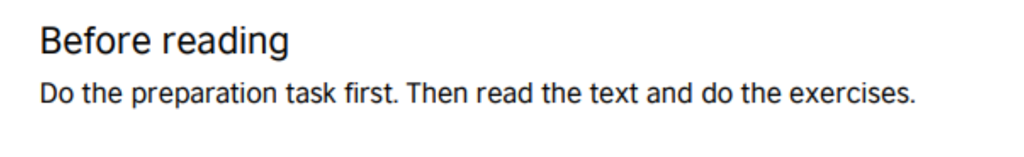

Slide 5
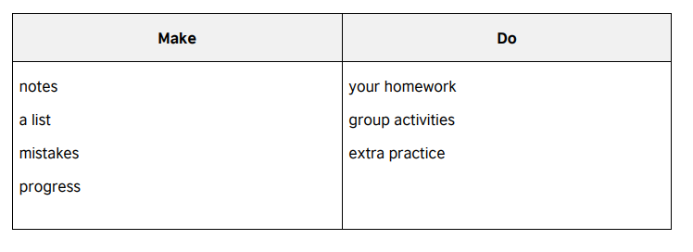
Answer key

Slide 7
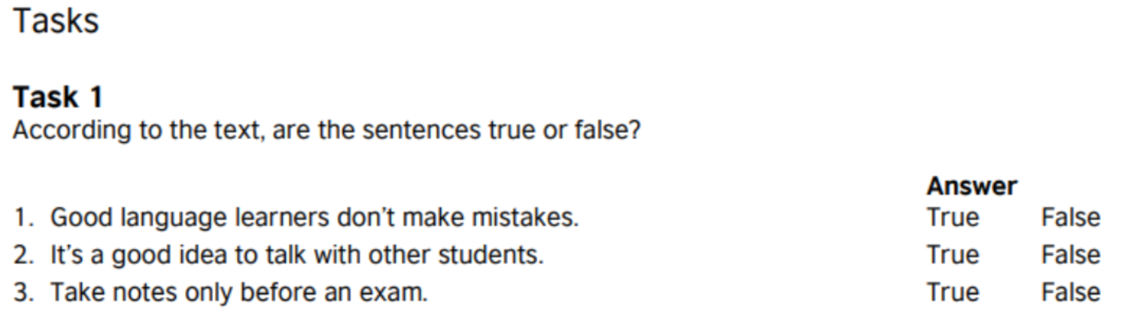
Answer key
1. F
2. T
3. F

Slide 8
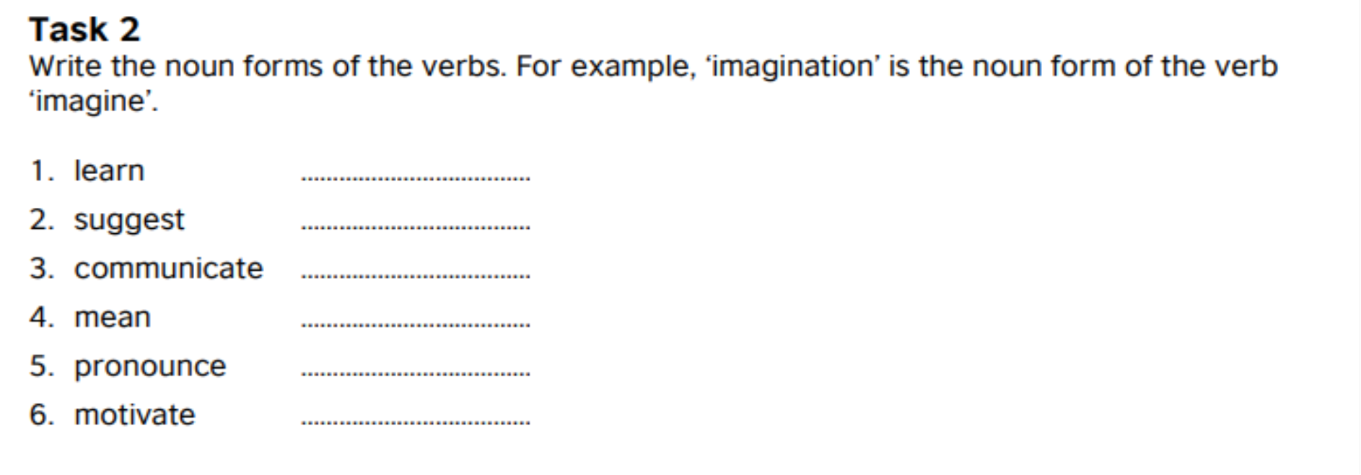

Slide 9
Answer Key
learner/learning
suggestion
Communication
meaning
pronunciation
motivation

Slide 12
Referrence
https://learnenglish.britishcouncil.org/skills/reading/pre-intermediate-a2/study-skills-tips

Slide 13
Reading 2 : An email from a friend

Slide 15
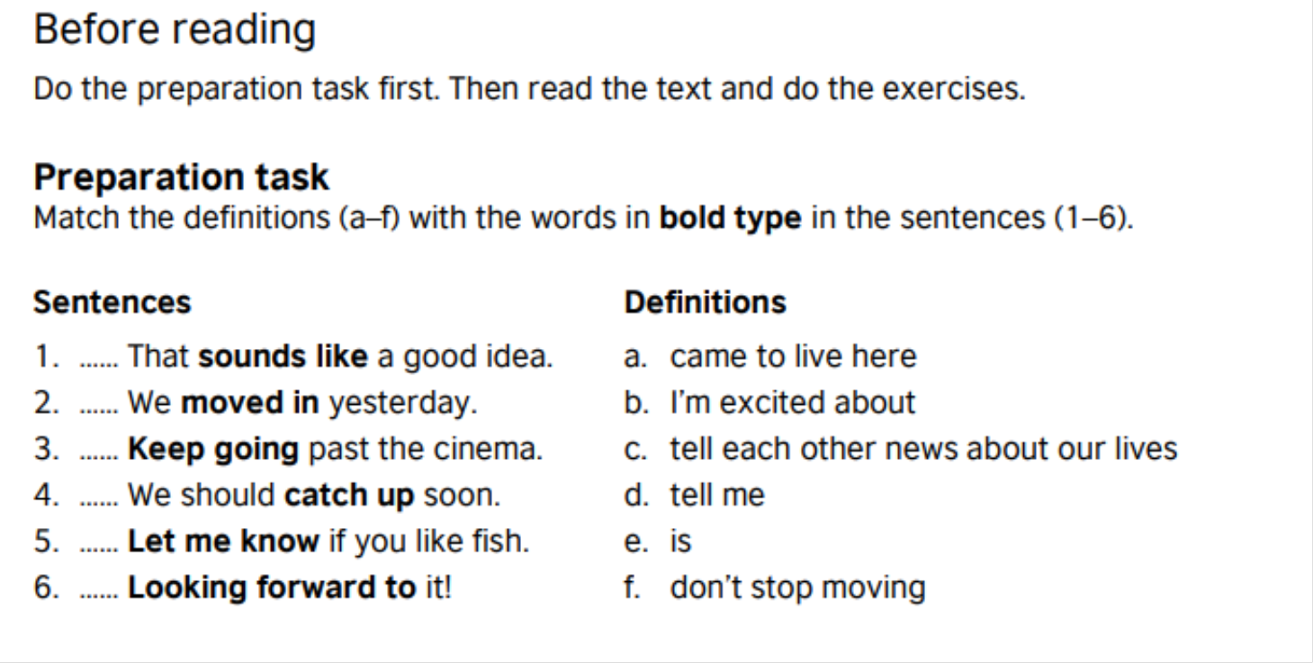
Answer key
E
A
F
C
D
B

Slide 18
Answer key
1. T
2. T
3. T

Slide 20
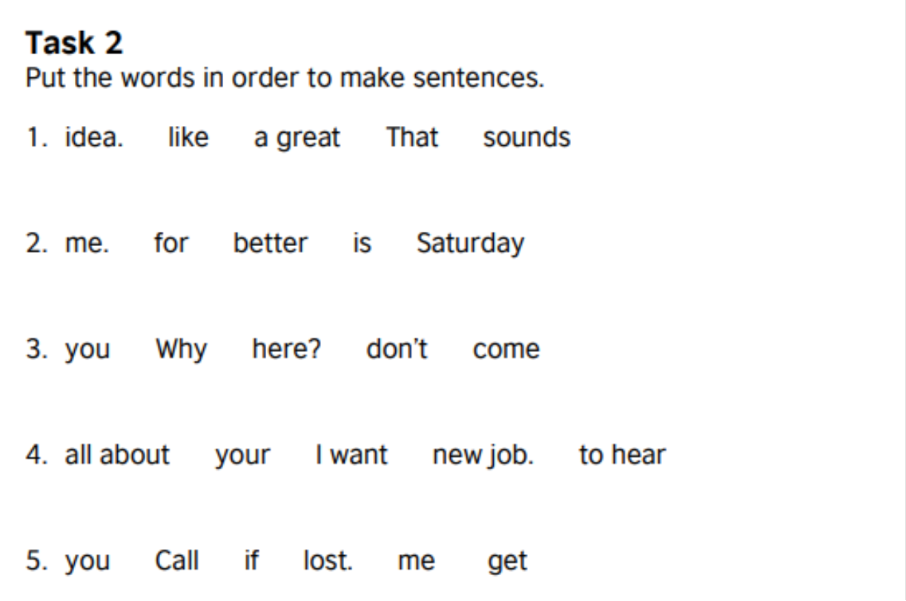
Answer key

Slide 23
reference
https://learnenglish.britishcouncil.org/skills/reading/pre-intermediate-a2/an-email-from-a-friend

Slide 24
Reading 3 : an end of term report

Slide 26
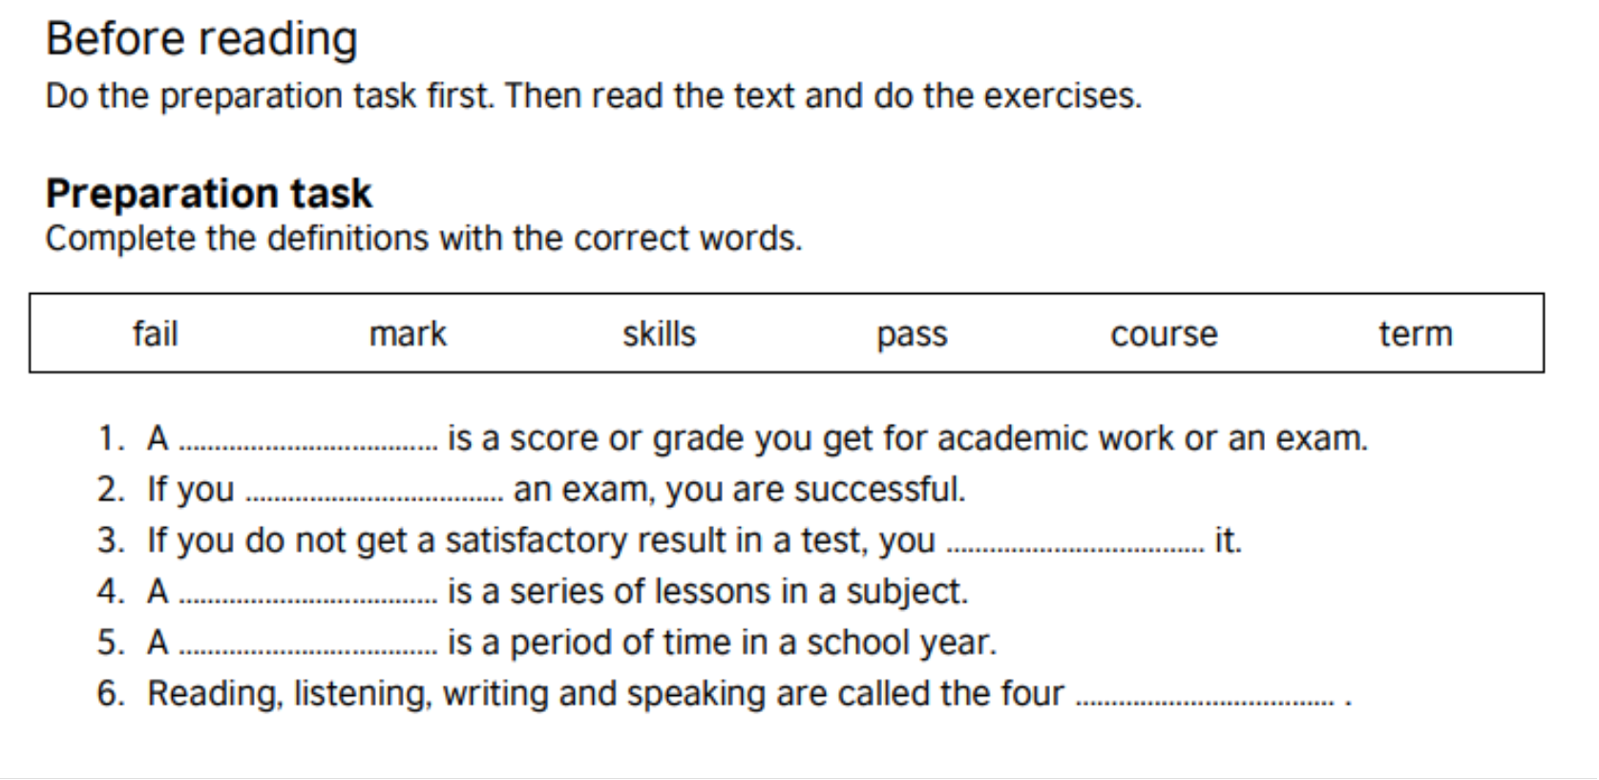
Answer key
mark
pass
fail
course
term
skills

Slide 30
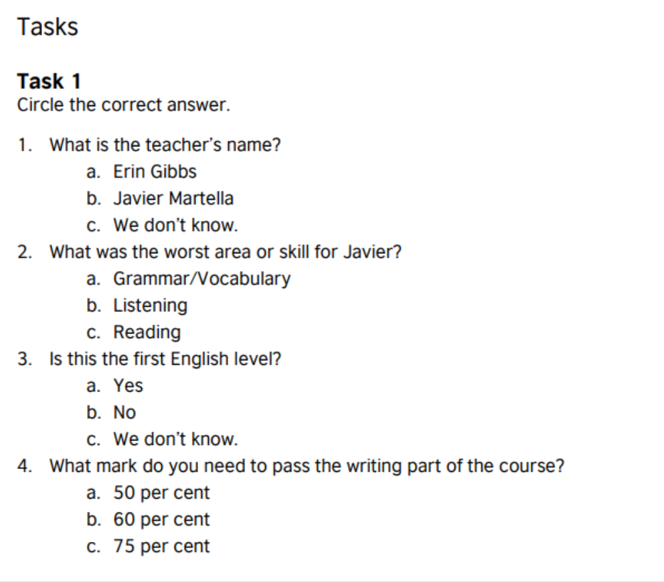

Answer key

Slide 32
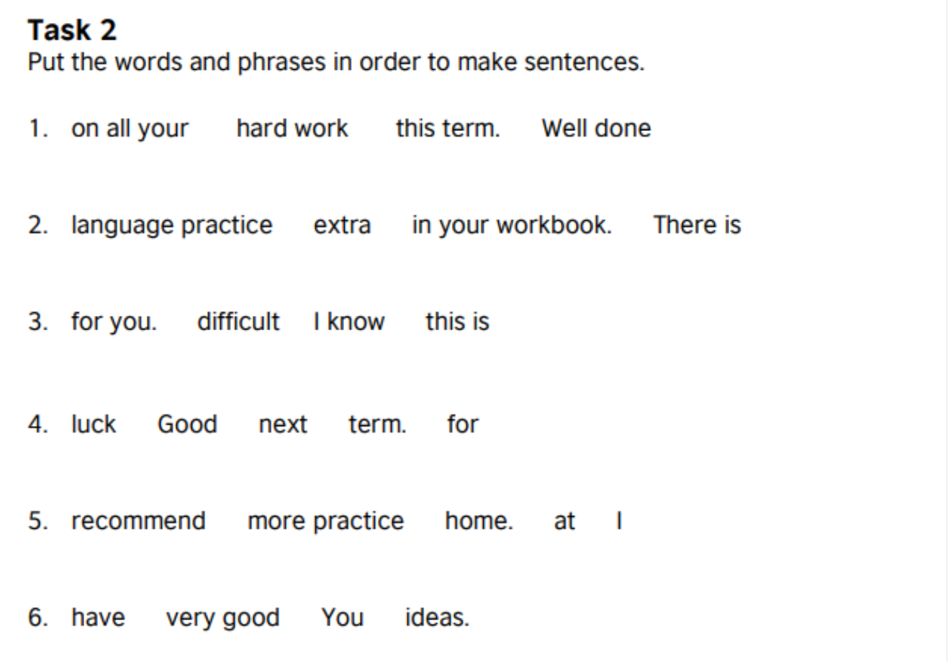
Answer key

Slide 34
reference
https://learnenglish.britishcouncil.org/skills/reading/pre-intermediate-a2/an-end-of-term-report

